Slide 1

Gradient Clipping

Slide 2

Reference
Chapter 11 (O'Reilly) of Hands-On ML
Youtube
Code

Slide 3
Data

Slide 4
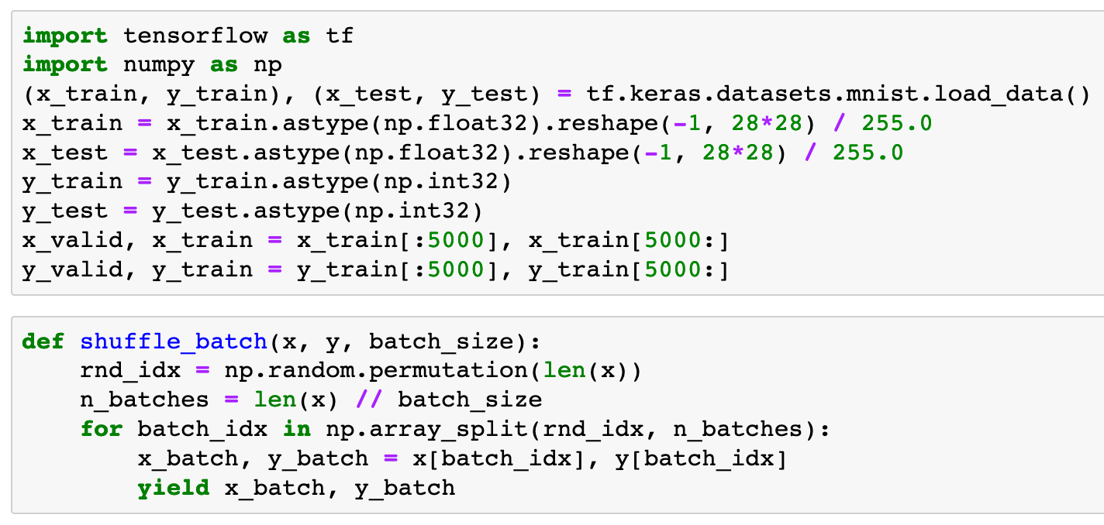


Slide 6
Warm Up

Slide 7
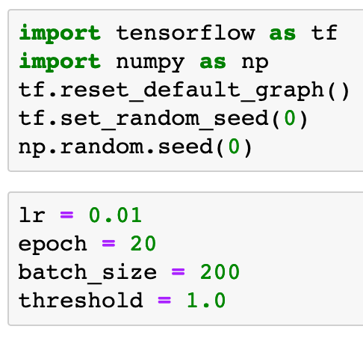

Slide 9
Graph

Slide 10
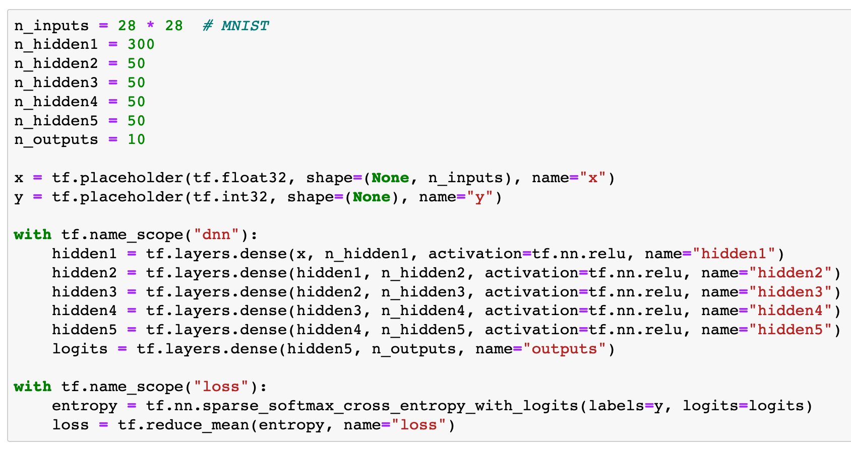

Slide 11
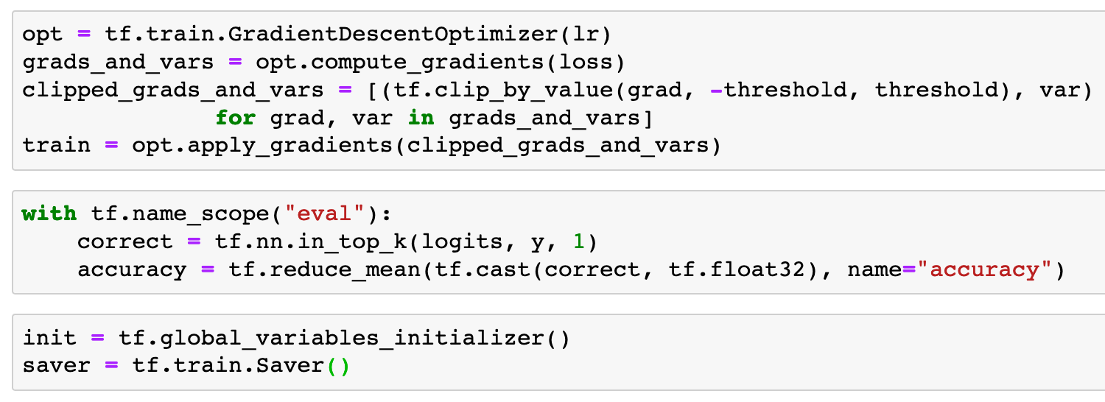

Slide 12
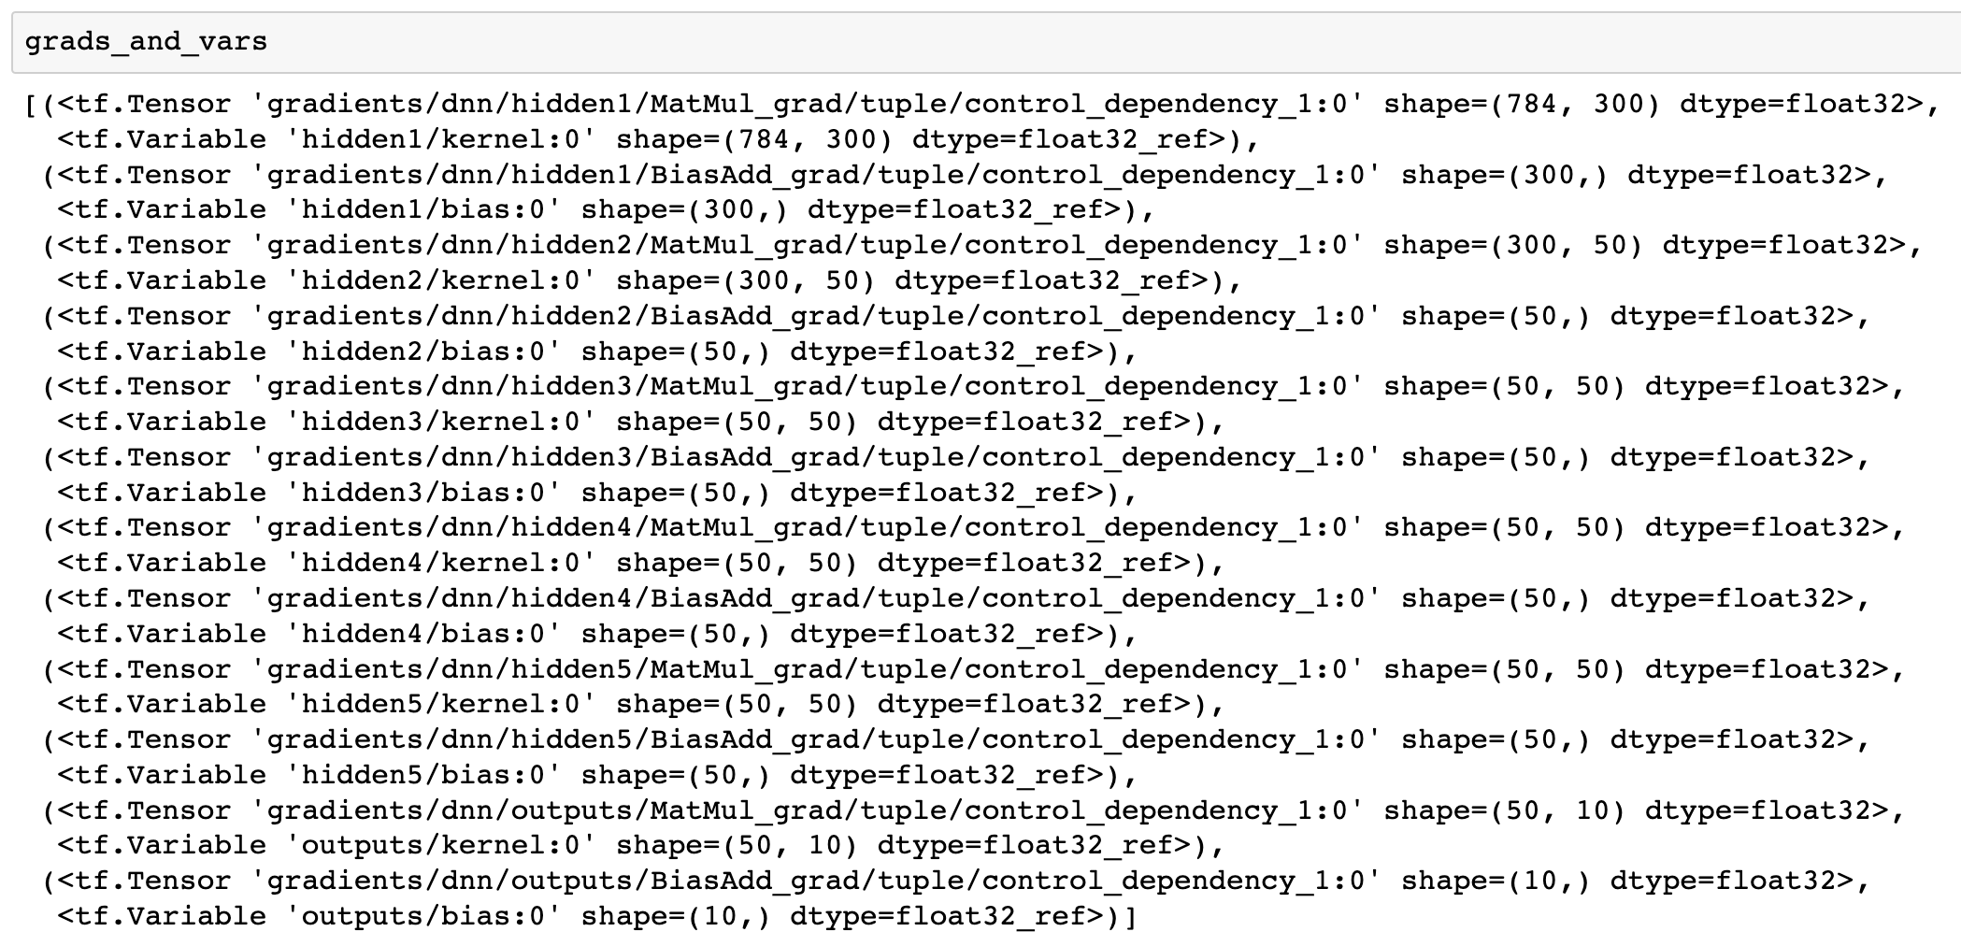

Slide 13
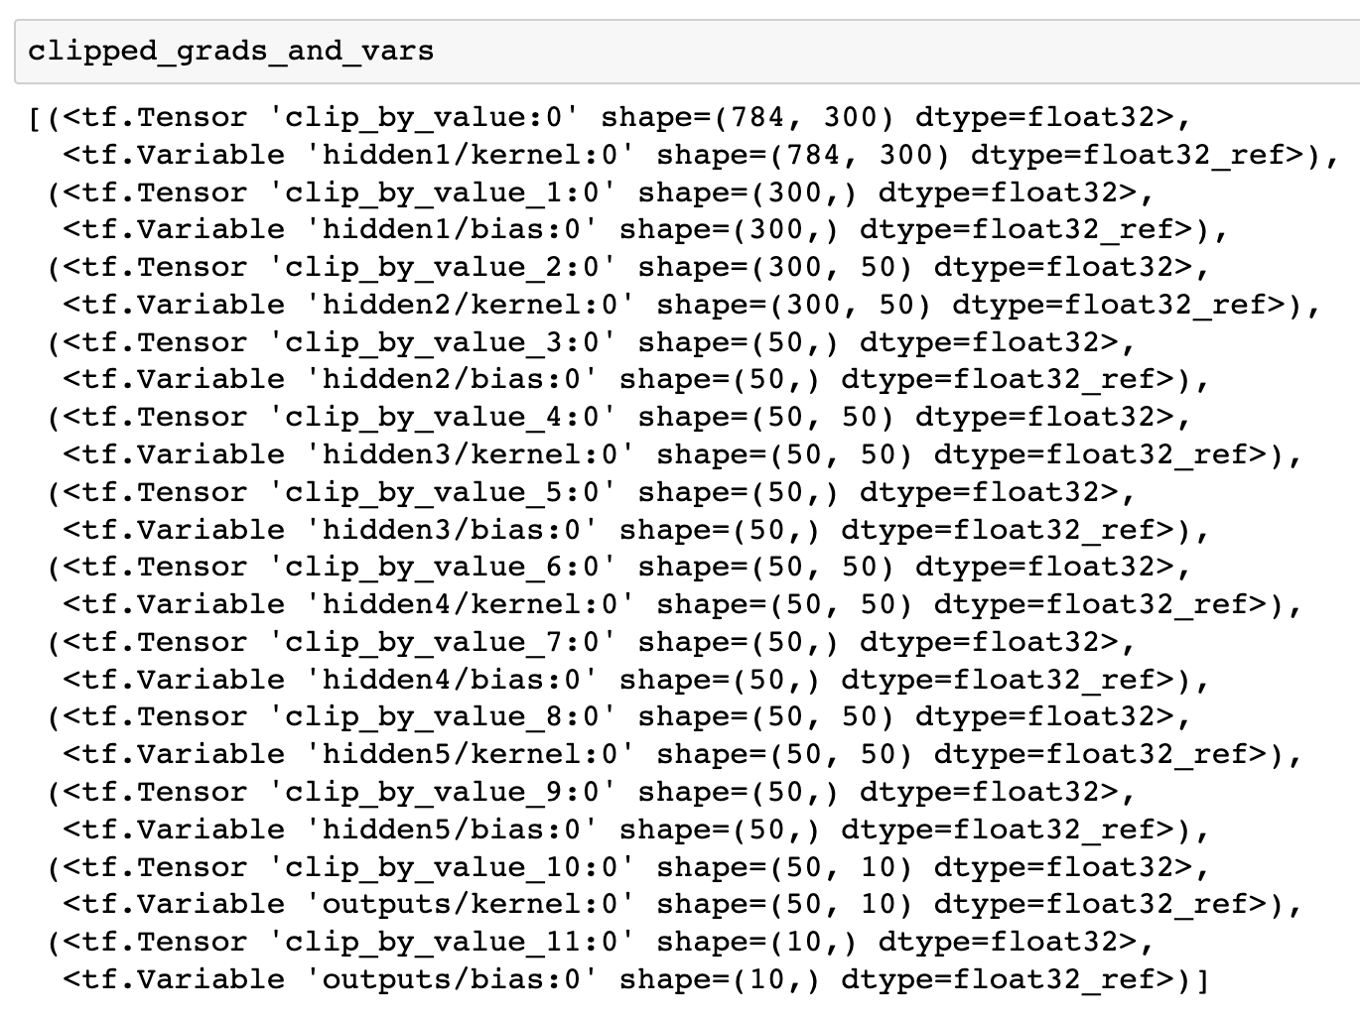

Slide 16
Session

Slide 17
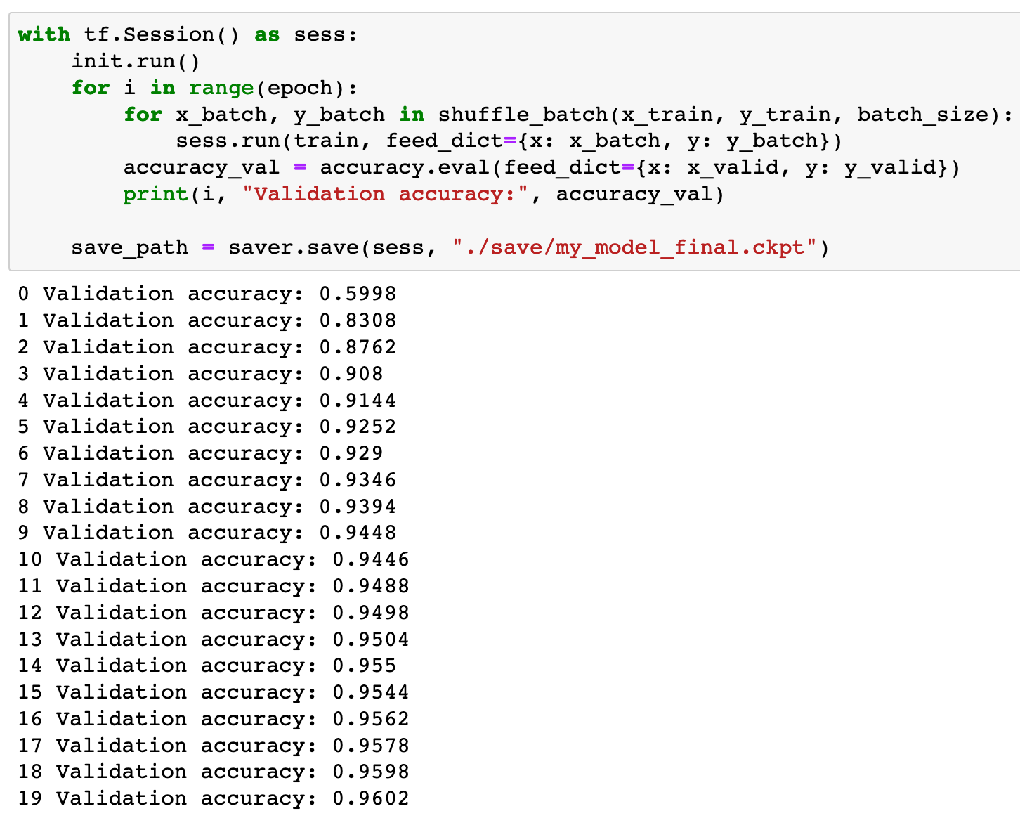

Slide 18
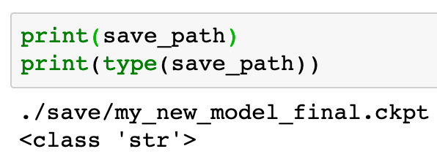

Slide 19
Now
Let’s Play with Code

